Slide 1
.NET
An “Application Development Platform”.
It is developed by Microsoft Corporation in the year 2000.
.NET Stands for Network Enabled Technology.
.NET is a Package or SDK or Framework also called as ".NET Framework".
Used for powerful software application development.
It provides necessary environment (IDEs, compilers, run time engines, libraries) for developing efficient and powerful applications for the end-users.
.NET provides a distributed object oriented platform for building
Stand-alone Applications(Console & Winforms)
Web-based Applications
Mobile-applications
Webservices

Slide 2
.NET FRAMEWORK
.NET Framework requires to run and develop any .NET Application
.NET Framework is a set of components, which are essential for develop any application in .NET Environment.
.NET Framework is a common Architecture for all .NET Applications.
.NET Framework Consist of following Components.
Languages
Technologies
Base Class Libraries
CLR[Common Language Runtime]

Slide 3
.NET Framework Architecture
VC#.NET
VB.NET
VC++.NET
F#.Net
Common Language Specification
Win Forms
Web Forms
Win Services
…..
.NET Framework
ADO.NET
Base Class Library
Common Language Runtime
Operating System

Slide 4
Languages
.NET gives choice of languages includes VB.NET, C#, F#, VC++ for developing diff kind on Applications. All of these compile to a Common Intermediate language.
Other .NET compatible languages are JScript, Perl, Cobol, SmallTalk, Scheme, Python, and many more

Slide 5
MSIL
MSIL stands for Microsoft Intermediate Language.
On compiling any .NET language, you will get MSIL.
Ex: C#.NET MSIL
Ex: VB.NET MSIL
Ex: VC++.NET MSIL
MSIL is a compile code of any .NET Language.
Also Called as Common Intermediate Language or Managed Code.
MSIL code will be saved in a file called "Assembly".
Its file extension can be either ".exe" or ".dll".
EXE file are directly executable files.
A DLL file shares the common code among many projects.
CSC
VBC
VCC

Slide 6
CLR
Common Language Runtime is the core component for .NET framework
CLR is Common Runtime Engine for all .NET Applications
All the .NET program execution is managed by CLR.
CLR uses Just-In-Time (JIT) compiler to compile CIL code into the machine understandable code(Native code).
.cs/.vb
CSC/VBC
MSIL
CLR
Native Code

Slide 7
Common Runtime Engine and CIL(Compilation Model)
.NET compilation model
VB.NET.C#/J#/C++ Code
.NET compatible languages compile to a platform-neutral language called Common Intermediate Language(CIL)
Compiler
Common Intermediate Language
The platform-specific CLR compiles CIL to machine-readable code that can be executed on the current platform
Common Language Runtime
01101100101011
10010101100110

Slide 8
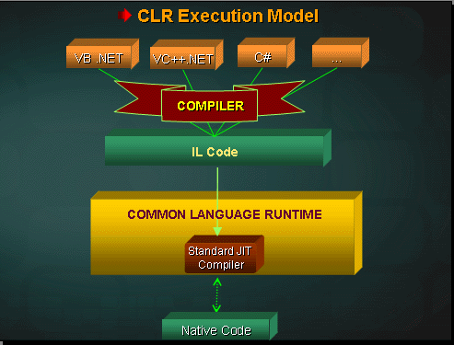

Slide 9
Base Class Libraries
Base Class Libraries are Standard Libraries common to all .NET languages.
Base Class Libraries provides some set of Common classes , which are useful for development of .NET applications.
Base Class Libraries are Predefined Libraries comes with .NET framework
All Base class Libraries are in the form of .dll(dynamic link libraries)
The Base class Libraries also called Assemblies or Namespaces.

Slide 10
Base Class Libraries
Important DLL files of BCL
System.IO.dll-work with filels and Directories
System.Threading.dll-base library for Threading
System.Data.dll-base library for Ado.net
System.Web.dll -base library for Asp.net
Note: System is the Base Library in .Net Framework.
Adding a Library to the Application
using System. Web----------C#
Imports System.Web----------VB.net

Slide 11
Core Features of .NET Framework
Language Independence
Multi Application Support
Multi Server Support
Common CLR to All the Languages.
Common Intermediate Language CIL(MSIL)
CTS
Base Class Library
Interoperability
Data Access
Web Application Development and Deployment
Security
Memory Management

Slide 12
Understanding Relationship Between CTS and CLS
CTS and CLS are parts of .NET CLR and are responsible for type safety with in the code. Both allow cross language communication and type safety.
CTS
CTS stands for Common Type System. It defines the rules which Common Language Runtime follows when declaring, using, and managing types. The common type system performs the following functions:
It enables cross-language integration, type safety, and high-performance code execution.
It provides an object-oriented model for implementation of many programming languages.
It defines rules that every language must follow which runs under .NET framework. It ensures that objects written in different .NET Languages like C#, VB.NET, F# etc. can interact with each other.

Slide 13
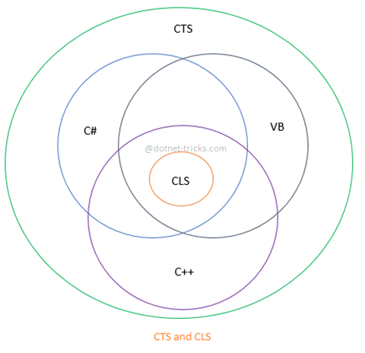
Understanding Relationship Between CTS and CLS

Slide 14
Understanding Relationship Between CTS and CLS
CLS
CLS stands for Common Language Specification and it is a subset of CTS. It defines a set of rules and restrictions that every language must follow which runs under .NET framework. The languages which follows these set of rules are said to be CLS Compliant. In simple words, CLS enables cross-language integration.
For example, one rule is that you cannot use multiple inheritance within .NET Framework. As you know C++ supports multiple inheritance but; when you will try to use that C++ code within C#, it is not possible because C# doesn’t supports multiple inheritance.
One another rule is that you cannot have members with same name with case difference only i.e. you cannot have add() and Add() methods. This easily works in C# because it is case-sensitive but when you will try to use that C# code in VB.NET, it is not possible because VB.NET is not case-sensitive.

Slide 15
Why CTS is Called Common Type System?
In .NET, every Data Type is internally represented by a class or structure. All the classes and structures related to Data Types are collectively known as CTS. As you know every language provides its own keywords for Data Types but internally all the languages which run under .NET framework use the classes and structures available in CTS.
For example, C# has int Data Type and VB.Net has Integer Data Type. Hence a variable declared as int in C# or Integer in vb.net, finally after compilation, use the same structure Int32 from CTS.
All the structures and classes available in CTS are common for all .NET Languages and purpose of these is to support language independence in .NET. Hence it is called CTS.

Slide 16
Multi Server Support
Microsoft SQL Server-- data storage
IIS(web server)-- A web server for asp.net app
Mobile ISS--A web server for mobile app

Slide 17
Interoperability
it represents cross language integration
which means develop logic in one language and used in other Lang
.NET support interoperability with .NET Lang and other .NET lang.

Slide 18
Data Access with ADO.NET
ADO is ActiveX Data Objects
This library provides a set of classes that provide data access services to access data from relational database , XML and application data.
ADO.NET 3.5 introduces Entity Framework which supports Entity Data Model (EDM), LINQ TO SQL etc.

Slide 19
ASP.NET
Active Server Pages.
ASP.NET is a web application framework to build dynamic web sites, web applications and web services .
It is a successor to Microsoft's Active Server Pages (ASP) technology.
Uses IIS as application server
IIS
ASP.NET Page
Web Services
HTML Page
Web page Request
HTML Response
HTTP/HTTPS
HTML Response
Client
Web service Request
SOAP Response

Slide 20
Memory Management
The .NET provides automatic Garbage Collection mechanism where by the unreferenced memory that was allocated by the code dynamically is freed automatically.
There is the possibility of going out of memory, which was there in programs written in languages such as C and C++, is minimized.

Slide 21
Visual Studio
IDE for creating .NET applications which are
Console based
Web based
Windows form based
Web services
Features
Page design
Automatic error detection
Debugging tools
IntelliSense (IntelliSense helps in auto completion by providing functions/methods names parameters etc.)
.

Slide 22
Visual Studio
Visual Studio 6.0
Visual Studio .NET (2002)
Visual Studio .NET 2003
Visual Studio 2005
Visual Studio 2008
Visual Studio 2010
Visual Studio 2012
Visual Studio 2013
Visual Studio 2015
Visual Studio 2017
Visual Studio 2019
Visual Studio 2022

Slide 23
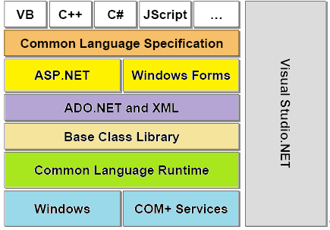

Slide 24
.NET framework
.NET 1.0
Visual Studio .NET 2003
Windows Server 2003
.NET 2.0
Visual Studio .NET 2005
Windows Server 2003 R
.NET 3.0
Visual Studio .NET 2005
Windows Vista, Windows Server 2008
.NET 3.5
Visual Studio 2008
Windows 7, Windows Server 2008 R2
.NET 4.0
Visual Studio 2010
Windows 7(Recommended)
.NET 4.5
Visual Studio 2012
Windows 7,8, Windows Server 8
.NET 1.1
Visual Studio .NET
Windows XP tablet and Media center

Slide 25
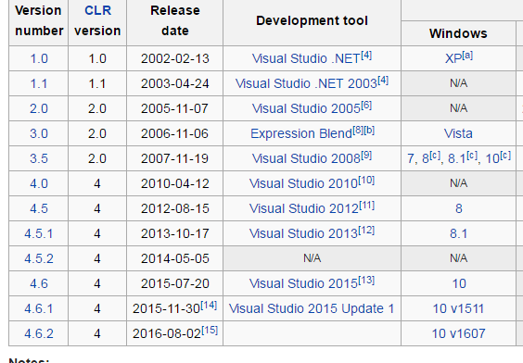

Slide 26
.NET Framework (4.0)
MEF
DLR
Parallel LINQ
AJAX-enabled Web sites
LINQ
EF
WCF
WPF
WF
4.0
ADO.NET
ASP.NET
WinForm
3.5
3.0
Base Class Libraries
2.0
Common Language Runtime

Slide 27
.NET Framework stack
WCF: Windows Communication Foundation (WCF) is a framework for building service-oriented applications.
WPF: Windows Presentation Foundation (WPF) is a framework for building rich UI, media, and documents.
WF : Windows Workflow Foundation is a framework for building workflow application.
AJAX-enabled Web sites: Websites that uses Asynchronous JavaScript and XML (AJAX) that allows features like partial page updates and asynchronous loading.
LINQ: Language Integrated Query provides unified querying capability across different data sources like SQL databases, XML documents, various Web services, objects.
EF: The Entity Framework is a ORM library for communicating backend data bases.
MVC:MVC stands for model-view-controller. MVC is a pattern for developing applications that are well architected and easy to maintain.

Slide 28
.NET Framework stack
MEF: The Managed Extensibility Framework is a library for creating lightweight, extensible applications which enables greater reuse.
DLR: The dynamic language runtime is a runtime environment that adds a set of services for dynamic languages to CLR. The DLR makes it easier to develop dynamic languages to run on the .NET Framework and to add dynamic features to statically typed languages.
Dynamic Language
C# and Visual Basic are statically typed languages where type must be specified at the design time.
Dynamic languages can identify the type of an object at run time.
Dynamic languages are Lisp, Smalltalk, JavaScript, PHP, Ruby, Python, ColdFusion, Lua, Cobra, and Groovy.
The purpose of the DLR is to enable a system of dynamic languages to run on the .NET Framework and give them .NET interoperability

Slide 29
Building blocks
Windows Platform
Visual Studio.NET
SQL Server 2008
Web Server(IIS)(Internet Information Service)

Slide 30
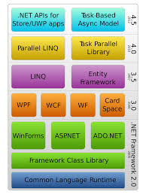
Notes:
Universal Windows Platform (UWP) apps - MSDN - Microsoft

